Slide 1

Exploratory Data Analysis
Video game sales
Name-Jaswanth Bhogi
Registration No-12012075
Roll No- RK20SSA27

Slide 2
About Dataset
This data set contains the list of video games with sales greater than 100,000 copies from year 1980 to 2020. There are 16,598 records(rows) and 11 columns.

Slide 3
Columns and Description
Rank - Ranking of overall sales
Name - The games name
Platform – Platform of the game
Year - Year of the game's release
Genre - Genre of the game
Publisher - Publisher of the game
NA_Sales - Sales in North America
EU_Sales - Sales in Europe
JP_Sales - Sales in Japan
Other_Sales - Sales in the rest of the world
Global_Sales - Total worldwide sales

Slide 4
Steps
Multivariate
Multivariate Analysis is a process of involving multiple dependent variables resulting in one outcome.
Data Sourcing Fetching the dataset from the internet, whether it’s from a public or a private source.
Univariate
Univariate analysis explores each variable in a data set, separately.
Bivariate Bivariate analysis is a kind of statistical analysis when two variables are observed against each other.
Data Cleaning
Removing anomalies/ outliers from the data, Removing or filling the null values with an appropriate data.
Data Sourcing
Kaggle: https://www.kaggle.com/datasets/gregorut/videogamesales

Slide 5
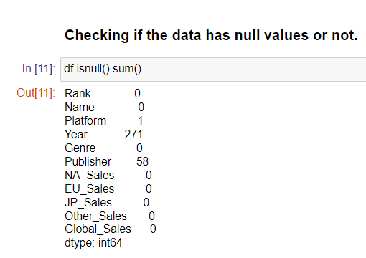

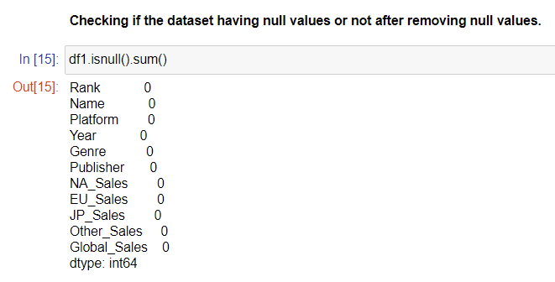
Data Cleaning
Data cleaning is the process of removing errors such as removing null values, deleting unwanted rows and columns, detecting outliers replacing them with the new values.
There are two methods two fix the null values :
1.Dropping.
2.Replacing with mode, median, and mean.
The null values in year column is 1.63% and publisher column is 0.35% as it is less percentage we can drop them using dropna() function.

Slide 6
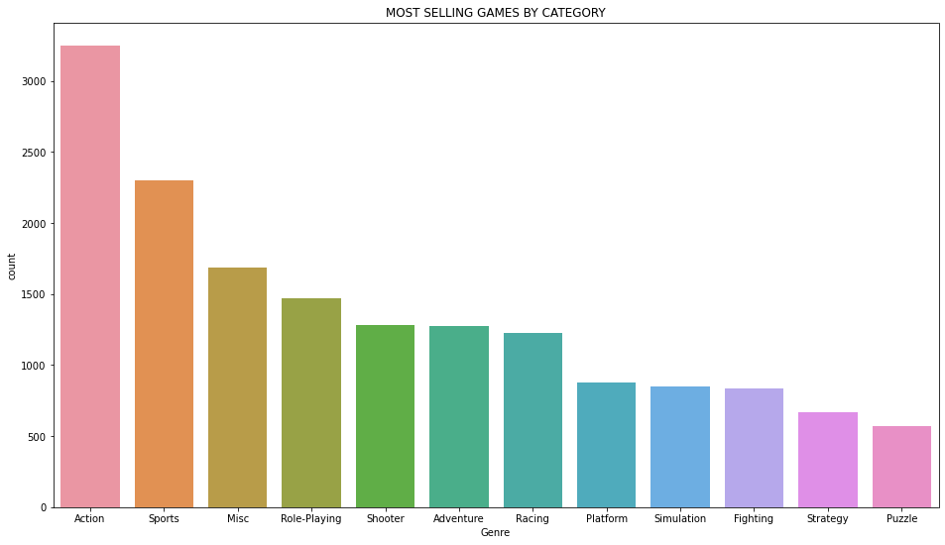
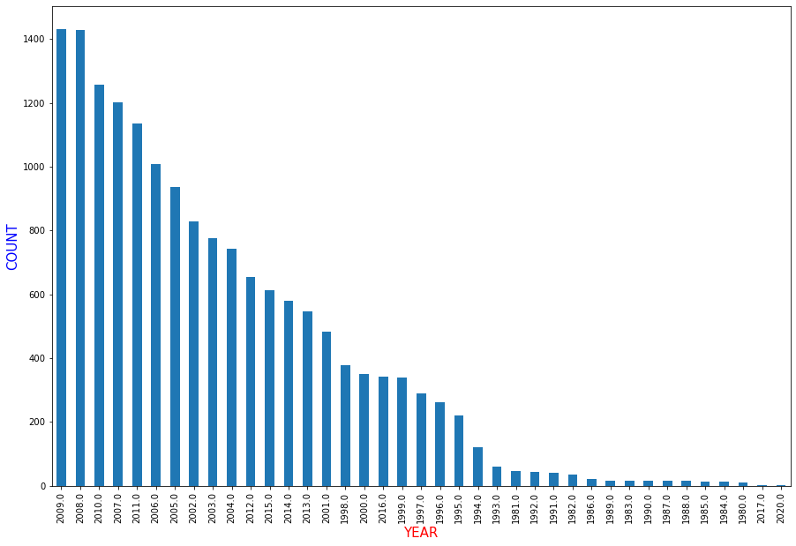
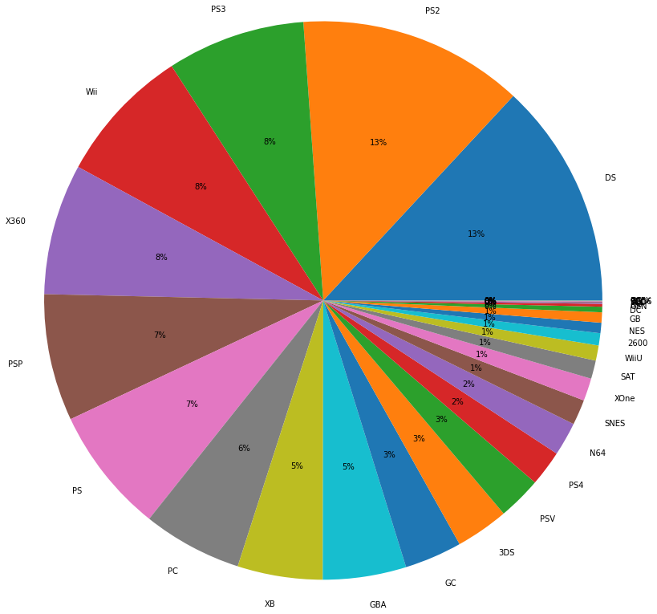
Univariate Analysis
Analyzing most and least selling games w.r.t genre and which platform has more number of games and which "year" has the most and least releases using bar graph and pie chart.
The games of Action genre has the highest sales and games of Puzzle genre has the least sales.
The years"2009","2008" has the highest releases and year 2020 has the least.
Hence, we can see that platforms "DS","PS2" has the highest number of games.

Slide 7
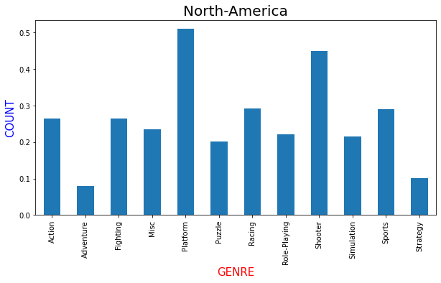
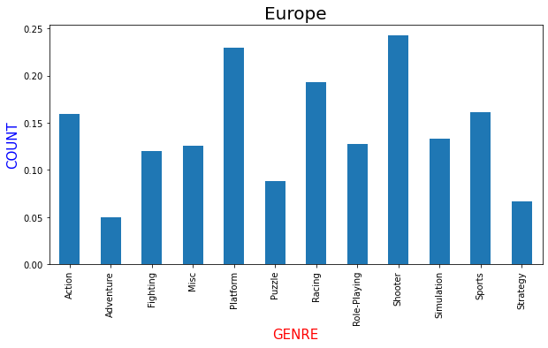
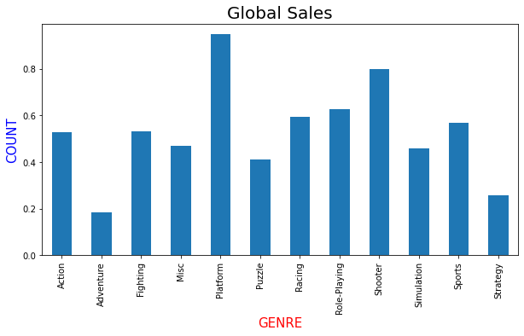
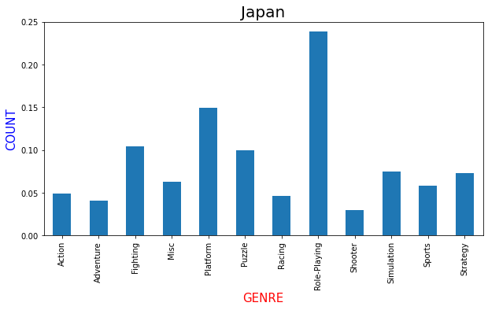
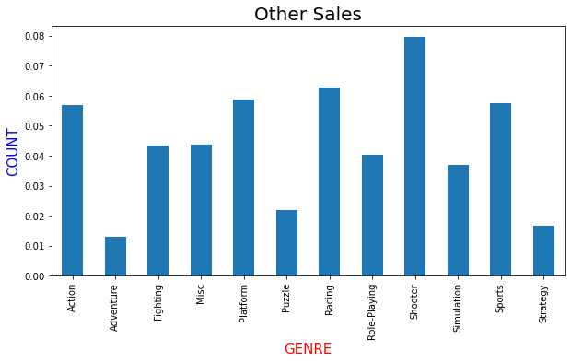
Bivariate Analysis
Analyzing which genre has highest sales in each type of sales using bar graph.
We can see that platform and
role-playing genres playing major role in all types of sales.

Slide 8
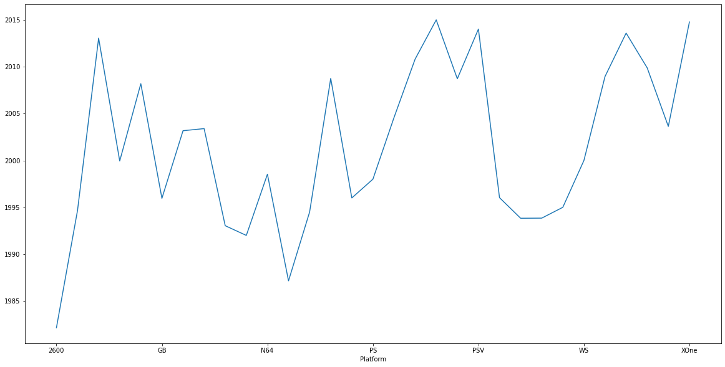
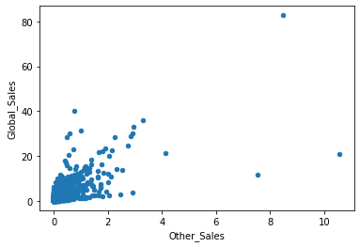
Analyzing which platform is used most in the recent years using line plot.
}
Clearly we can see that mainly platforms like "PS","PSV","XOne" are used in the recent years.
Checking if there is any correlation present between other sales and global sales using scatter plot.

Slide 9
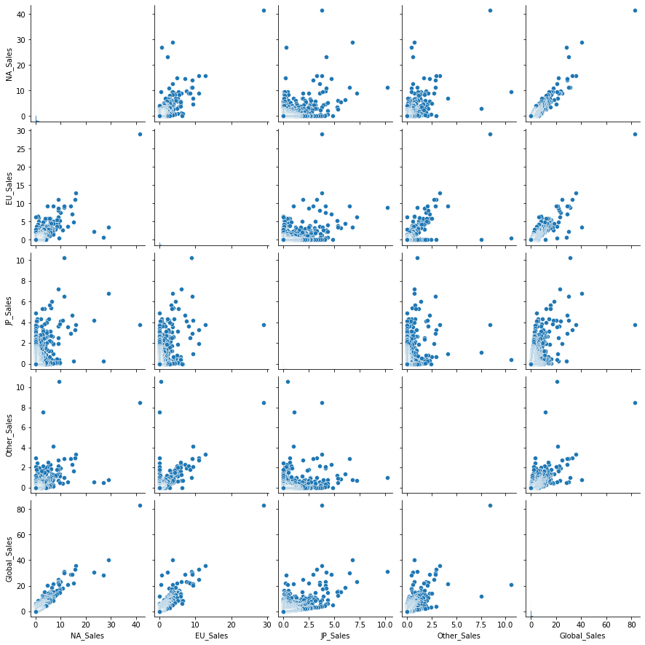
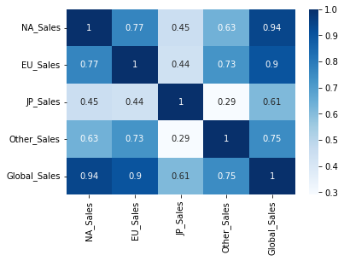
Multivariate Analysis
Finding the relation between different sales using heat map and pair plot.
North-America Sales and Global Sales has the highest relation and Japan Sales and Other Sales has the least relation.

Slide 10
Conclusion
• This dataset is about the video game sales in different countries.
• Among the countries north America has the largest number of sales and Japan has the less number of sales.
• Platform and Role-playing based games has the highest sales.
• Coming to types of video games action genre games are mostly sold and puzzle genre with the least percentage.
• platforms like PS, PSV, XOne are used in the recent years
• From the year 1980-2020 Large number of games are sold in the year 2009 and 2008 less in 2020.

Slide 11


Thank You.
GITHUB https://github.com/jaswanthbhogi/Exploratory-Data-Analysis
REFERENCE https://learn.upgrad.com/
https://www.kaggle.com/

